Slide 1

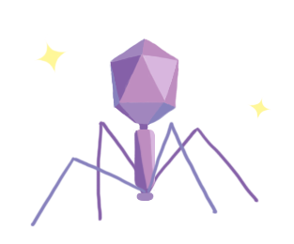
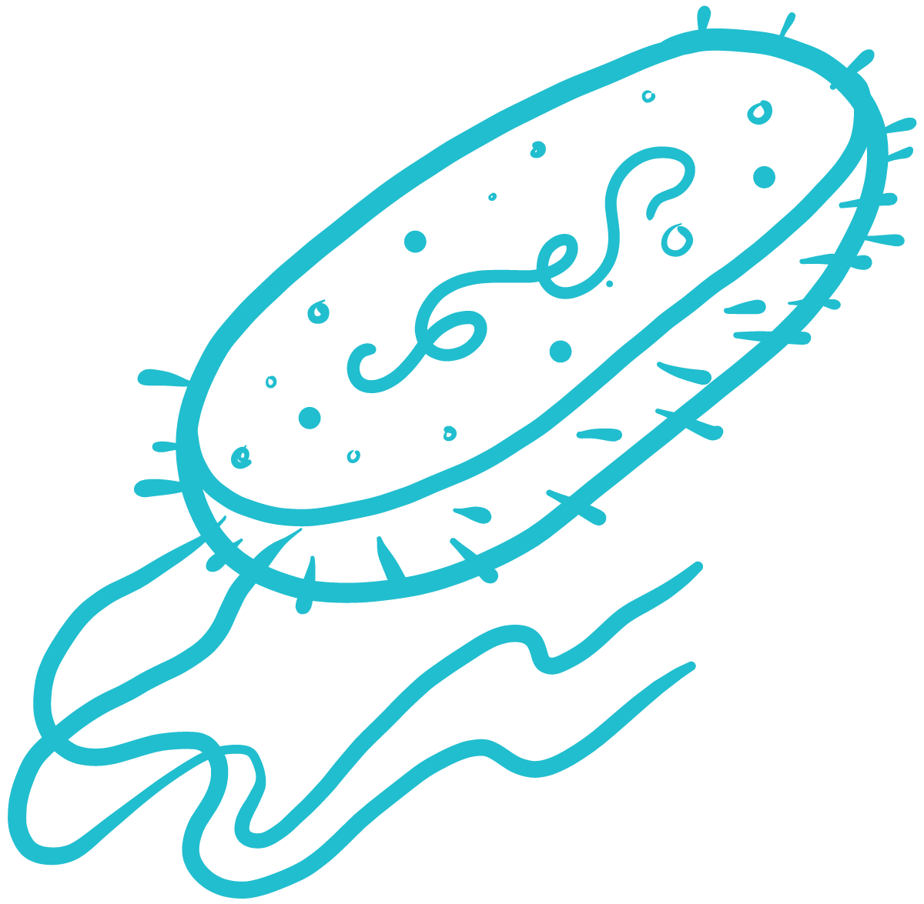
Exploring Machine Learning Models for
predicting Phage-Host Interactions for
Phage Therapy
Ryan Nguyen | Hayat Awais Malik | Gia Hagos
BME230A Final Presentation

Slide 2
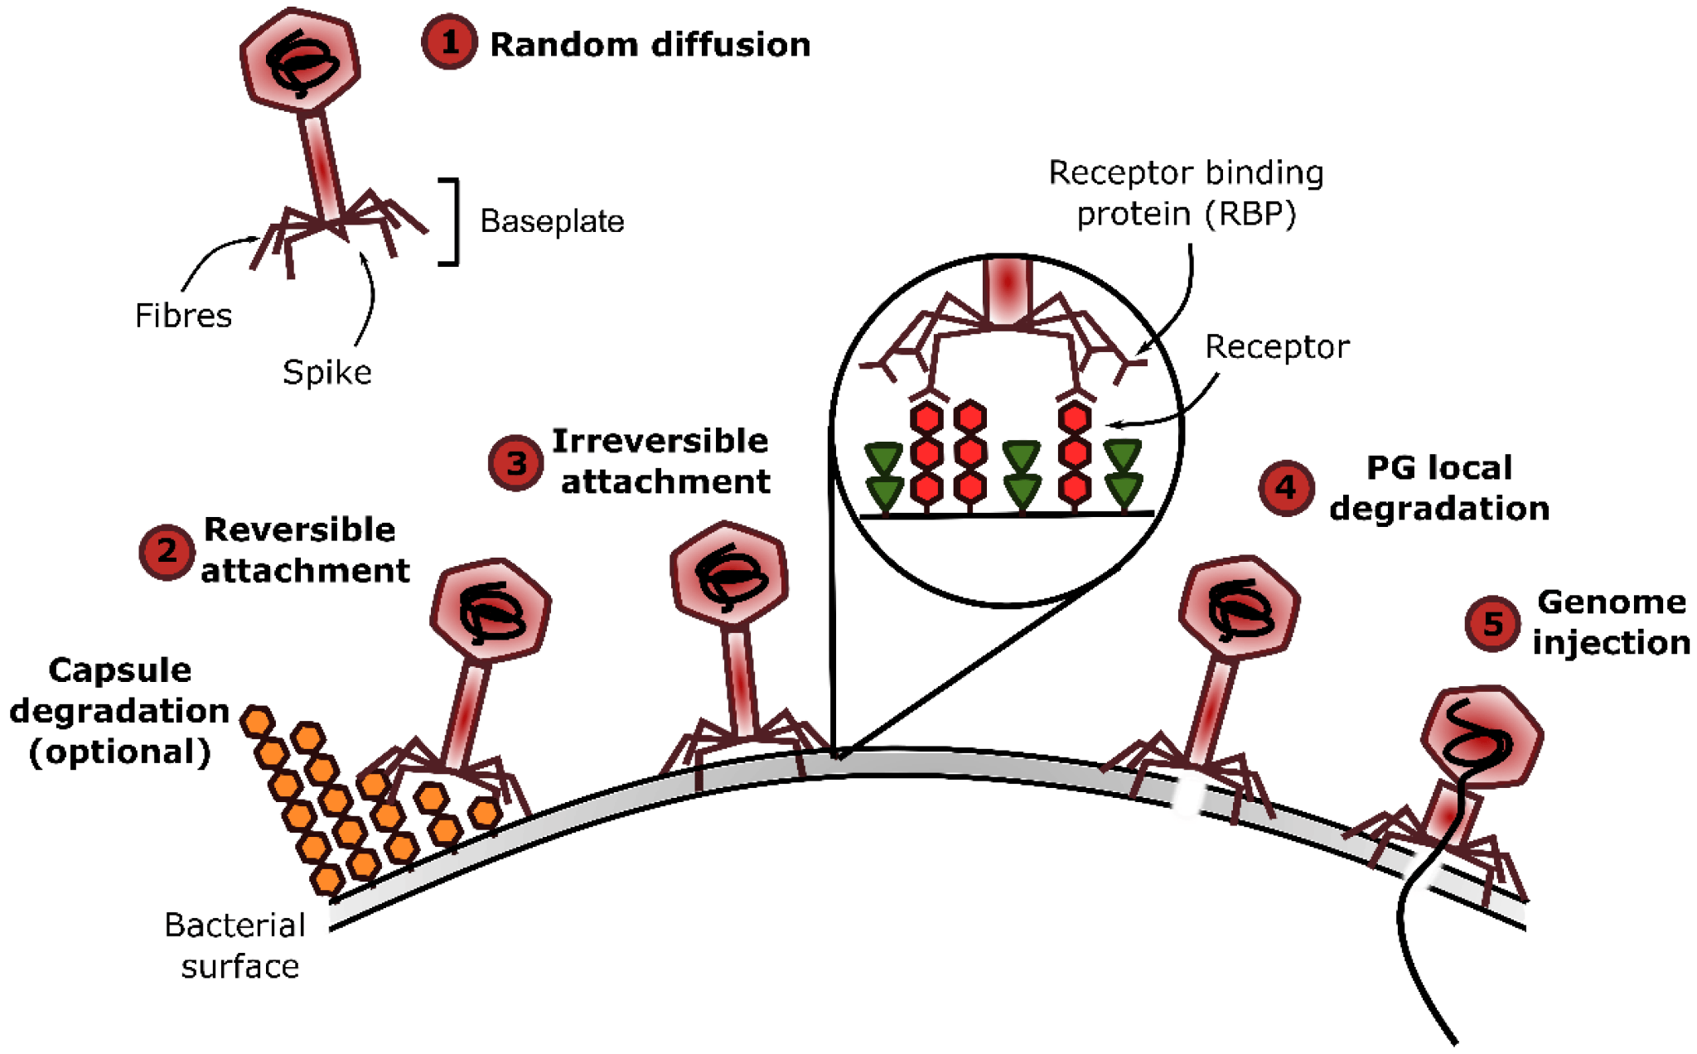
Background
Antibiotic overuse has led to the growth of antibiotic resistance. Development of new antibiotics using current strategies is costly and time inefficient.
Phage therapy is an alternative approach that aims to use the lytic properties of bacteriophage viruses to kill bacteria.
Phage-host interactions are highly specific, meaning correct matches are needed to have phages kill bacteria.
Machine learning can identify-phage host pairs based on features pulled from protein data.
Leprince, Audrey, and Jacques Mahillon. "Phage adsorption to gram-positive bacteria." Viruses 15.1 (2023): 196.
Notes:
Antibiotic overuse -> leads to antibiotic resistance.
Developing new antibiotics is very costly and time inefficient - the rate at which they can evolve is very rapid
This is why there is a need for phage therapy
What is phage therapy
Its using the lytic properties of phages for treating bacterial infections
The succes of phage therapy is all dependent on correct matching between the phage and host - they are very specific in their binding
Previously it was through experimental, thats time consuming and labor intensive
Sequence alignment tool, genomic data and protein information and then we can machine learning for making predictions.

Slide 3
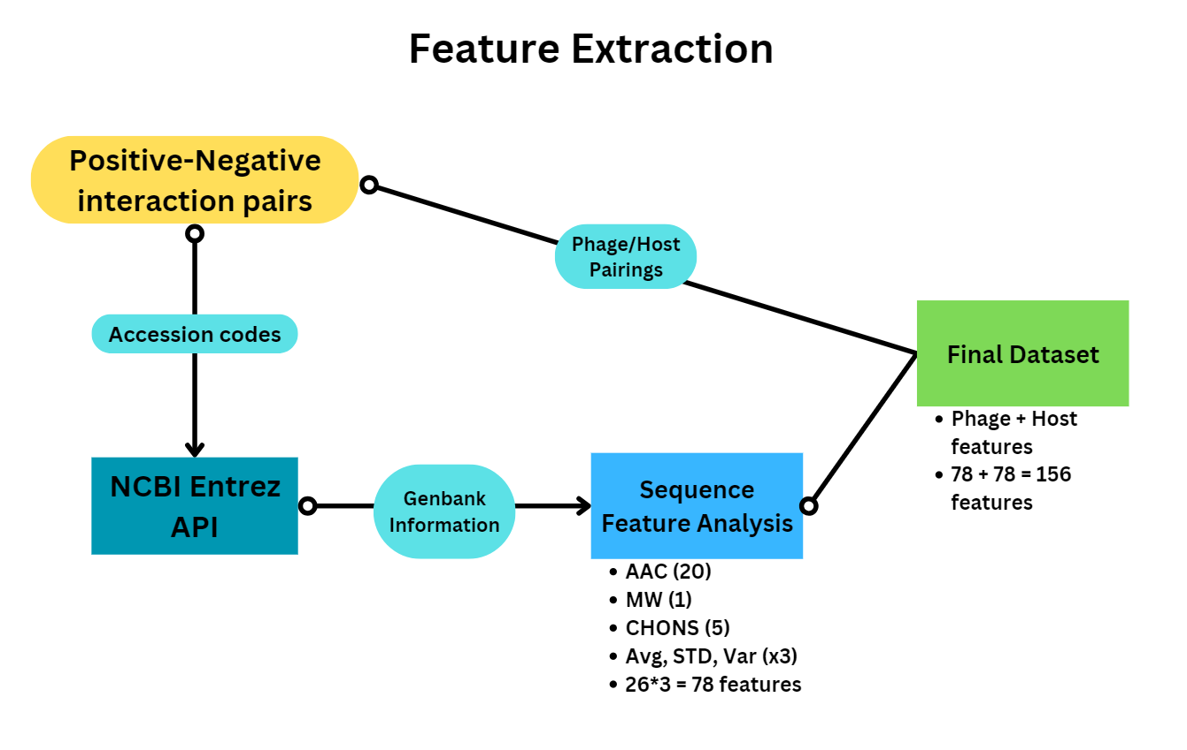
Dataset Creation
Positive interactions from PhagesDB.org
Retrieve GenBank accession codes for phages and hosts with complete genomes
Exclude unnamed and hypothetical proteins under a sequence length of 30
Generate features from GenBank protein sequence data
Notes:
For positive interactions we create a list of confirmed pairings using accession codes of both phages and hosts.
From here we can use the NCBI Entrez API to grab genomes from these accession codes. This returns all sorts of information, most importantly the proteins and their primary structures. Side note, getting these genomes was an absolute PAIN. With about 3700 accession codes it took three hours to get all the genomes. The first run through, I made it an hour before I got hit with errors caused by edge cases.
Anyways, the information can be filtered, and we retrieve protein primary structures, excluding hypothetical and unnamed proteins under a certain length, and use that information to generate features.
To avoid redundancy in database queries (again, time consuming), these obtained features were stored with accession codes for later use.
Afterwards we use the positive and negative interaction pairs, grabbing the features for both and combining them together to form a data point.

Slide 4
Feature Encoding
Protein: "major head protein"
MATKEQLATANIYEFKKHVELALQETK………………………PVLKGTKAA
‘_p’/’_h’ indicates whether feature belongs to phage or host
Elements marked by ‘-’ to avoid confusion with amino acid codes
Phage | Host | A_avg_p | A_std_p | … | N-_var_h | MolW_var_h
NC_019549 | CP004005 | 0.212689 | 0.179871 | … | 0.011457 | 0.045797
Number of proteins not constant -> Generalize characteristics of all proteins in a genome as statistical measures
Protein Primary Structures analyzed using Biopython ProtParam module, formatted into pandas dataframes for easy calculations
Amino acid counts (20), total elemental composition of sequences(5), molecular weight (1)
Average, standard deviation, variance of each feature is calculated (26*3)
Notes:
Pairing is dependent on protein-protein interactions between virus surface protein and host receptor proteins, so it’s reasonable to conclude that the proteins of these phages and hosts should be used to generate features for machine learning.
This seems fairly straightforward however the number of proteins and annotations for those proteins are wildly inconsistent. Some genomes may have a protein for receptors while the other does not, and this variation can make it hard to format genomic information in a way that’s usable for machine learning.
A solution is to generalize the characteristics of all non-hypothetical proteins in a genome by using the primary structures of every protein.
This means taking characteristics like amino acid count, elemental composition, and molecular weight of each protein in a genome, and finding the average, standard deviation, and variance. This means we can have a consistent number of features regardless of genome size, and also helps by giving more numbers for the model to crunch.

Slide 5
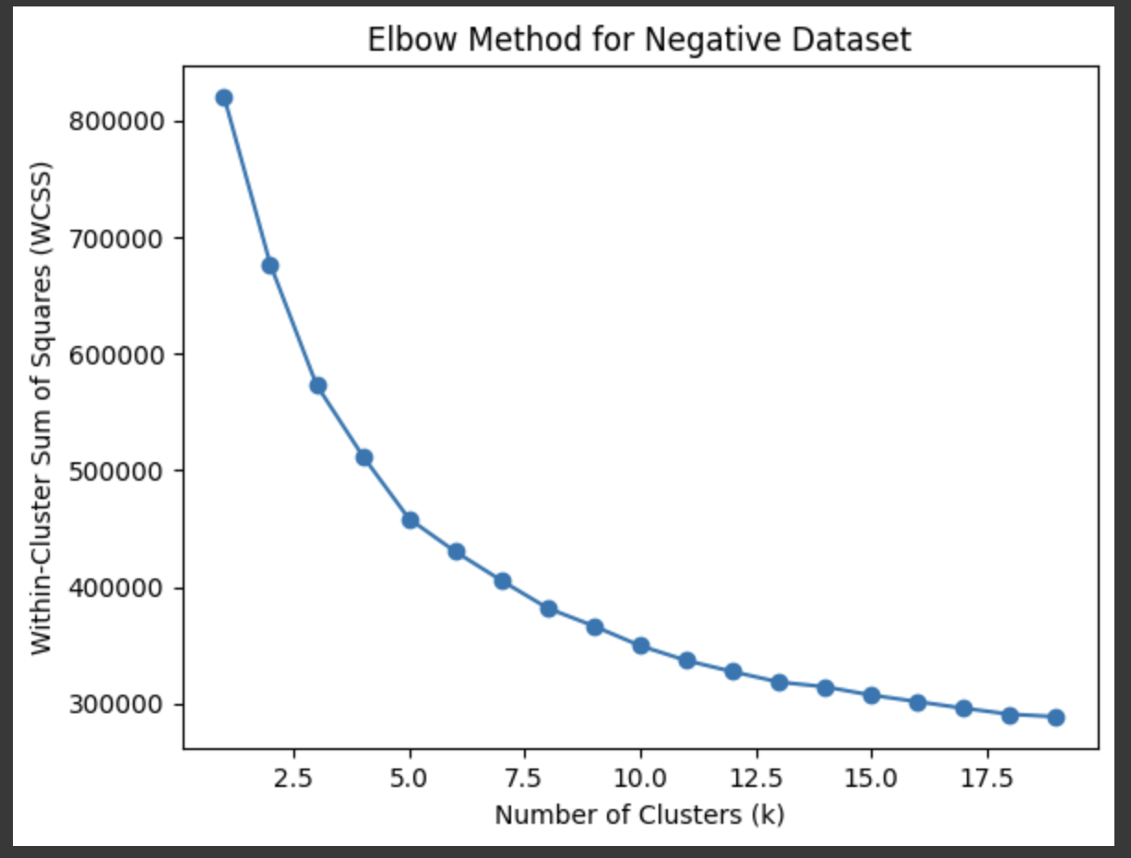
K Means Clustering
Problem: Absence of Experimentally Verified
Negative Interaction Data
No public database records negative interaction between phages and host
Create putative negative dataset
Process and Normalize the data
Find Optimal value for clustering the data
https://colab.research.google.com/drive/11Ml-XvWNOHN2OM2uSlpzp-mDkRh2SOQz?usp=sharing
Notes:
One of the challenges that exists in this problem is the absence of confirmed negative interaction data of phages and hosts. In an ideal scenario, we would have experimentally verified pairs of phage and hosts that were known to not interact with each other. However, no such data is available publicly.
Hence, to create a negative interaction pair database we first put together all phages and hosts in our list that did not
have positive interactions. We then utilize K means Clustering algorithm to construct a balanced dataset of reliable negative data.
The first step was to process the data by removing missing values and normalizing the data using
minimum maximum scalar normalization.
We use the elbow method to find the optimum value of k for our K-means
clustering algorithm. We choose a range of values (in our case, 1 to 20) for the potential number of clusters (k) and run
the clustering algorithm for each. For each result, we compute the within cluster sum of squared distance (WCSS) which
is the sum of the squared distances between each data point and its assigned centroid within each cluster. This measures the compactness of the cluster.
We plot the number of clusters with the respective WCSS values [shown in
Figure 2] to see that the rate of decrease in WCSS slows down significantly. Looking at the plot, we identify the point
where adding more clusters does not significantly improve the model’s clustering quality, in this case we picked k=7

Slide 6
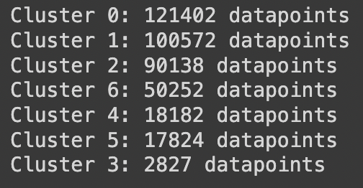
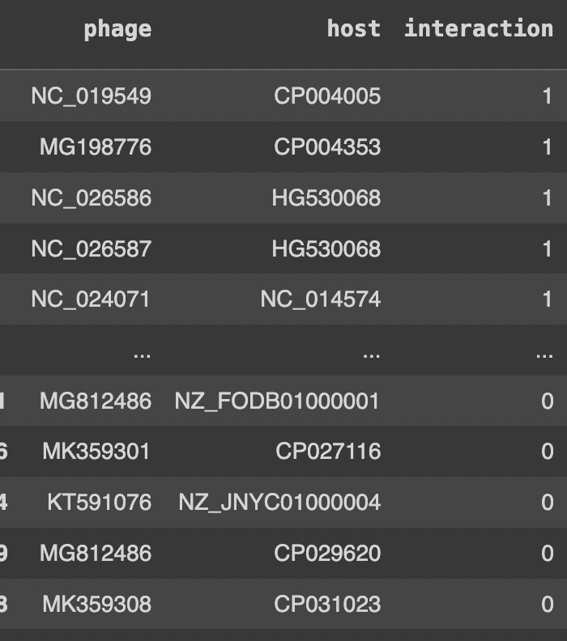
K Means Clustering
Cluster data with optimal value of K
Selecting representatives of the Negative dataset
Capture variability and distribution of dataset
Compute distances to Positive Interaction Data
Extract high reliable negative data points
Balanced Dataset
Notes:
With our optimum value of k, we cluster the negative dataset to obtain the optimum clusters.
To ensure coverage of the entire negative dataset, we select representatives from each of the clusters as the points closest to the centroids.
Plus, to ensure we capture the variability of the dataset, the number of points chosen from each cluster are proportionate to the size of the cluster. This ensures that our representative set captures the diversity and distribution of the negative dataset.
Finally, we calculate the dissimilarity or distance between each selected representative with the positive instances in
our positive interaction dataset. We choose the negative instances that are ranked highest in terms of dissimilarity to
the positive instances as these are the ones most likely to be negative interactions.
The number of points selected was consistent to the size of our positive interaction dataset to ensure a balanced dataset.
In this way, we constructed a highly reliable negative interaction dataset that is representative of our data and consistent in length to our positive
samples.

Slide 7
Classification Models
https://colab.research.google.com/drive/1qnosnt9dfp7NEf_IsVlu3s0UDzJNOM9c?usp=sharing
~6000 samples and 158 features
Split data into training, validation and test sets
Random
Forest
K Nearest Neighbour
Neural
Network
Optimized and validated each model’s hyperparameters

Slide 8
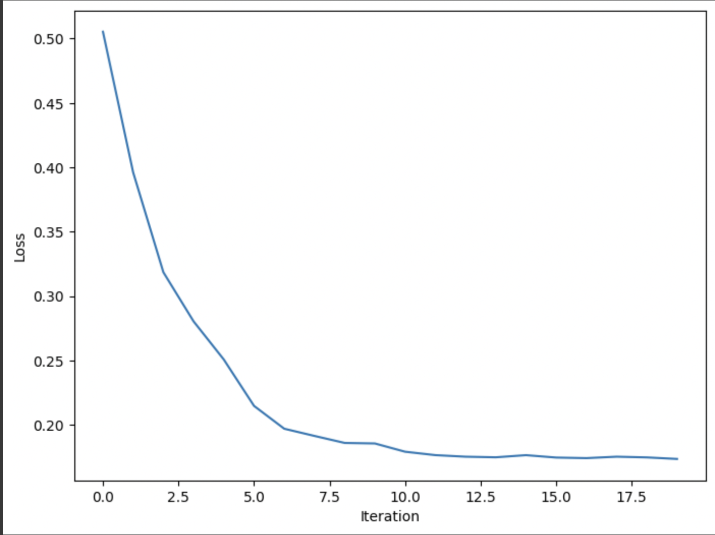
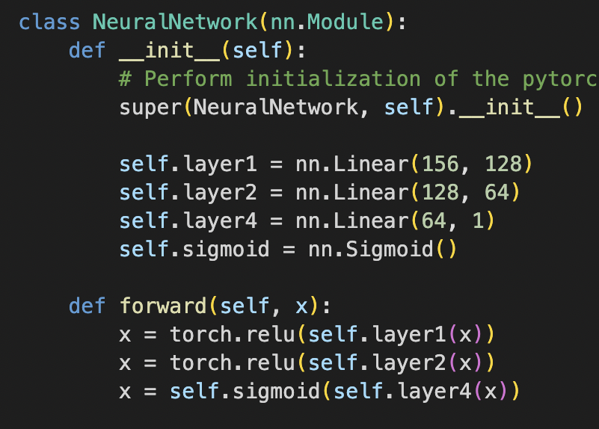
Random Forest
Neural Network
K Nearest Neighbour
Maximum number
of estimators
Maximum depth
Number of
k neighbours
Model Architecture
Loss Function/Optimizer
Learning rate
Epochs
Batch Size
Notes:
Random Forest is an ensemble learning method that combines multiple decision trees to make predictions. For our
Random Forest Classifier, we utilized Random Search method to tune the hyperparameters such as the number of
estimators (between 100 to 400) and the maximum depth (between 1 to 30) using cross validation to obtain the best
parameters for our model.
The K-nearest neighbour method bases its predictions on the similarity of each case (i.e., interaction) with its k
closest neighbors. Hence, its performance is impacted greatly by the choice of the hyperparameter ’k’ in determining
the label. To select a value of our k, we chose a range of values between 2 and 30 and explored the classifier for each
value of k. The optimum value of k (in our case k=3) was selected and validated with the validation dataset.

Slide 9
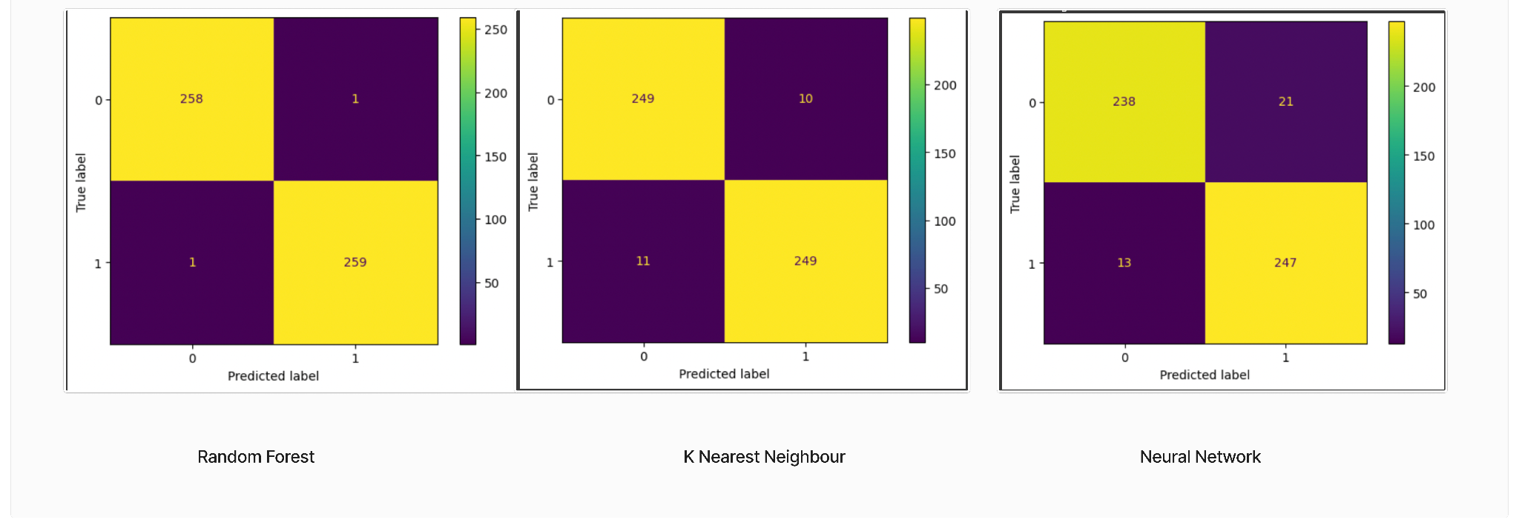
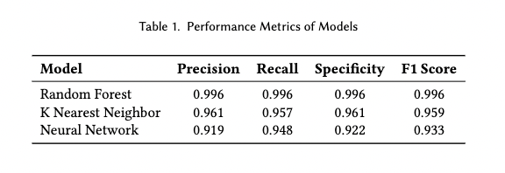
Results and Performance

Slide 10
Questions?
Thankyou!
Ryan Nguyen | Hayat Awais Malik | Gia Hagos
BME230A Final Presentation

